Slide 1
Mojaloop a 1st Class Citizen on Microsoft Azure
ONLINE PI-18 OSS Community Meeting – Technical Session
Microsoft and Mojaloop Status a Non-Official Workstream Report
Prepared by:
Greg McCormick

Slide 2
Agenda
Mojaloop on Azure, why is it important
Adjusted Scope
Scope Reminder
Work Completed / Work In Progress

Slide 3
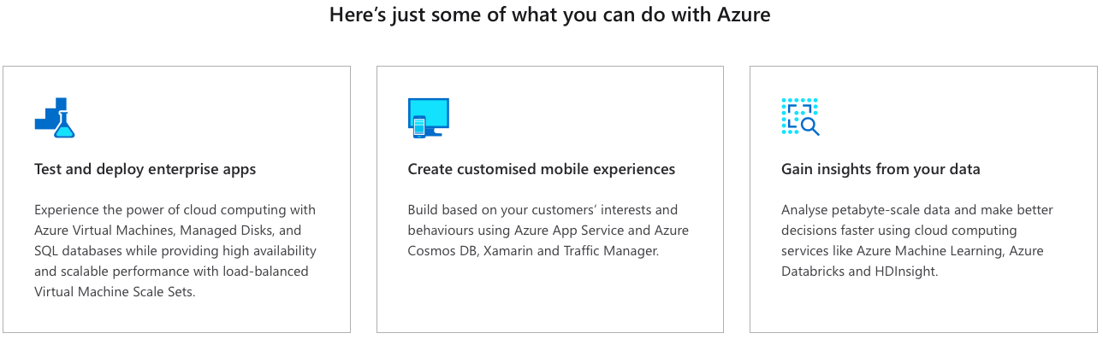
Why is this important?
We will reach a lot more people.
A lot more options.
We get to do a lot of validation and artifacts, paid for by Microsoft.

Slide 4
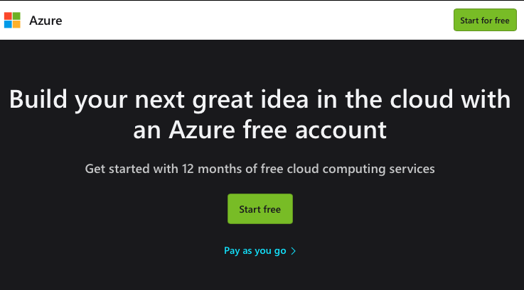
Ideas can only come from access before they lead to Innovation

Slide 5
Mojaloop, a First-Class Citizen on Azure
A project to make Mojaloop a First-Class Citizen on:
Microsoft Azure
Microsoft Marketplace
Microsoft Azure Stack
A hybrid cloud solution that allows cloud management but uses local resources and therefore meets a countries data residency rules
The goal is to optimize performance &
Ease of installation and management
ARM Templates for multiple purposes to be created
Leverage Azure Management Portal
Deployment
Active management
Alerting and reporting

Slide 6
Adjustment to Scope
Finite Time and Budget
Various delays
Availability of resources in staffing and subject matter experts
Complicated and involved
Although the Event Hubs poses a huge potential for savings, we have moved it to the end of the project and will make as much progress as we can on it.
Azure stack was deemed to be more beneficial to the community as it allows for Azure cloud management while providing in country data sources, eliminating any data residency issues.

Slide 7
Scope
Complete
Pure OSS Baseline Setup in Azure Kubernetes Service (AKS)
Stateful components
To reduce admin overhead for a switch operator all stateful components will make use of Azure managed platform services. Kafka will be removed from the AKS cluster and services will be updated to make use of either HDInsight or Event Hubs with the later being a far more cost-effective method.
Percona Mysql being replaced by Azure databases for Mysql
Scripting Phase 1
In the first phase of scripting the components in use so far, will need to commissioned and decommissioned rapidly to not exhaust the project's azure spend budget
Complete
Adjusted Scope
Complete
Complete
For Cloud

Slide 8
Scope (cont’d)
API Management
Implement the Azure Api Manager with Mtls to ingress controller of AKS. This will be used as an alternative to Ws02.
Scripting Phase 2
Adding in scripting to automate work carried out with API management components
DFSP Authentication
Creation of a DFSP ID and CERT validation policy to authorize participants
Testing Toolkit
Explore if we need any changes or alternatives due to platform and changes
Complete
Complete
For Cloud
Complete

Slide 9
Scope (cont’d)
Scripting Phase 3
The finalization of any IAC work that was not covered in the prior phases.
Documentation
This is for any documentation required by the Azure marketplace or stack teams.
The creation of any getting started style Azure guides will also be covered here.
Stretch Goals (nice to haves)
Application Insights

Slide 10
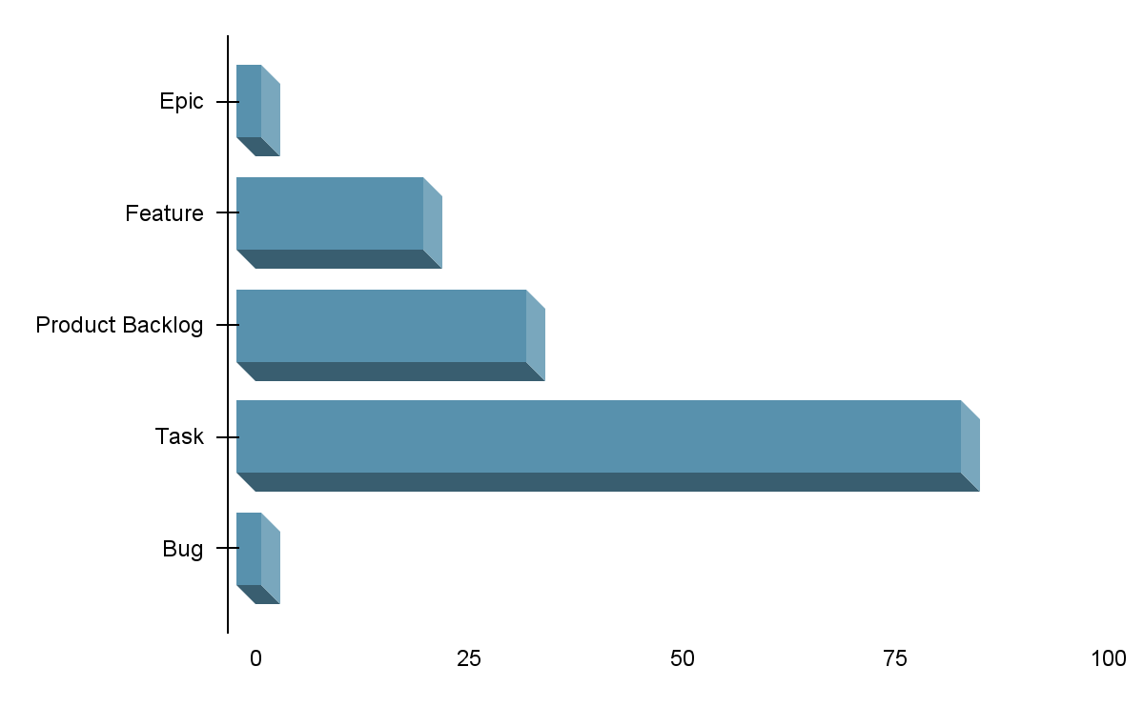
Project Break Down
3 Epics - Replatforming, Azure Stack Porting, Azure Marketplace
22 Features
34 Items in the backlog
85 Tasks
3 Bugs

Slide 11
Feature Areas
DBaaS Integration
Scope confirmation
Architecture / Design
AKS Deployment
Baseline Azure Infra
API Manager
Messaging
Ops Tooling
Baseline Deployment of OSS
Testing / Validation Automation
Marketplace Requirements and Design
Marketplace Install Payloads
Marketplace Deployment Scripts
Stack Architecture / Design
Stack Dev/Test Deployment [Hub then HCI]
Optimization [Prod]
IaaS / AKS MySQL (Azure stack HCI) determination
IaC - scripting
Event Hubs Re-visit?

Slide 12
Working with the community
The work is well underway, and we had expected to work more with the community than we have at the point. I think some reprioritization has gotten in the way of that. But we would welcome involvement where it makes sense. Tom we should touch base, and I can connect anyone else that wants to be involved.
The team needs to be in sync with the community and
The community needs to be in sync with this effort.
The has worked closely with the dev ops workstreams as that is where most of the changes will be confined to.
Again any “shims” or adjustments to code need to be made it will be discussed with the TGB and DA.
The intention is not to do anything that will create a fork.

Slide 13
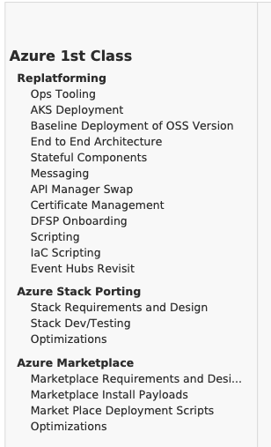
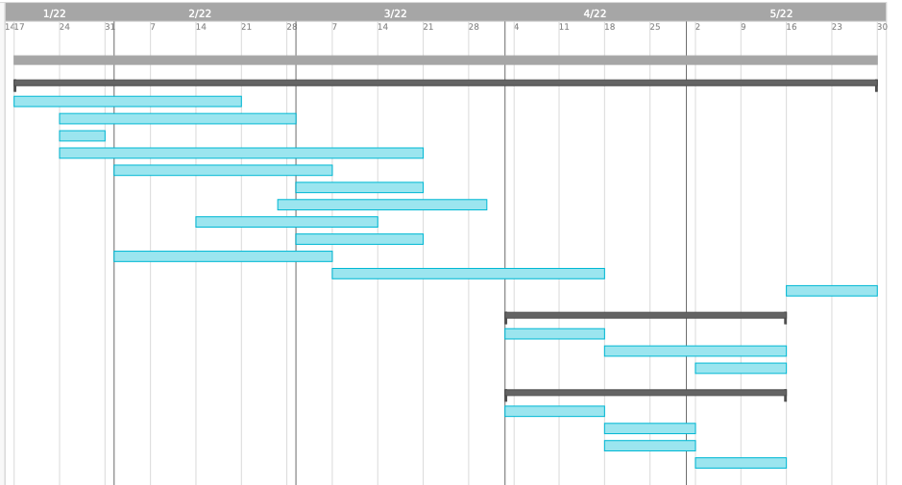
Very High Level WBS
Project Slack from 22 May Through June

Slide 14
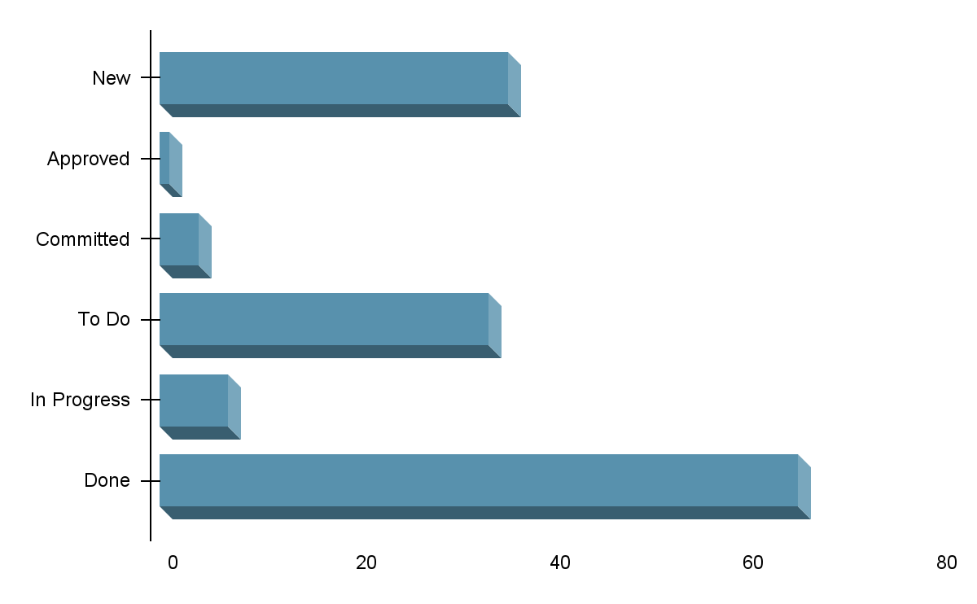
Current Work Items and Backlog
36 Items
1 Item
4 Items
34 Items
7 Items
66 Items

Slide 15
Detail of some items that have been completed.
Team kick-off / huddle | Cert authentication of client requests | Azure Stack Team
Logical components | Repo Design & Setup | Build containers locally
Deploy test AKS cluster | Oss DevOps team meeting regarding container changes | Push to Sybrin devops on docker hub (public)
Install AKS | Create local dev env. for functions | Test connection of all containers after DB fixed
AKS Deployment | Create local function - Validate DFSPID from dB | Bulk containers found to be "disabled" = enabled them
[ SPIKE] test deployment of latest helm chart | Prepare | [ SPIKE] events hubs
Install of the default OSS as a baseline | Fulfill | Pass Testing Toolkit
Documented in-scope and out-of-scope items | Position | submit PR's
Setup testing mySQL | Transfer GET | Add Mojaloop services to API manager
Modify helm charts to polnt to Mysql PAAS | Admin | Validate via postman
Define params needing changing | Timeout | API Manager
Test deployed connection with replaced connection info | Notification Handlers | API Manager
DNS service discovery remapping | Mojaloop API Adapter | Event Hub
fix TTK test URL reference | Admin Service | Review core team technical debt's affect on this project
MySQL as a service deployment | Fork above list of repo's | KeyStore
Read the Docs | Create authentication policy using DFSP ID | Meeting with Johan
Deploy test Event Hub | Make changes to Docker Files | Azure Function
Deploy API Manager | Prepare branch and repo's for PR's | ARM templating of current components

Slide 16
What’s Left – Through June
Project runs through June
Current tasks complete by mid May
Revisit Event Hubs from mid May
Utilize mid May through June for slack and lingering items
June for refining documentation
June for shifting artifacts to Microsoft repositories
June for shifting artifacts to OSS repositories

Slide 17
Thank You

